Slide 1
Figures from Pure and Mixed Spectra
June 11, 2019
David Gray

Slide 2
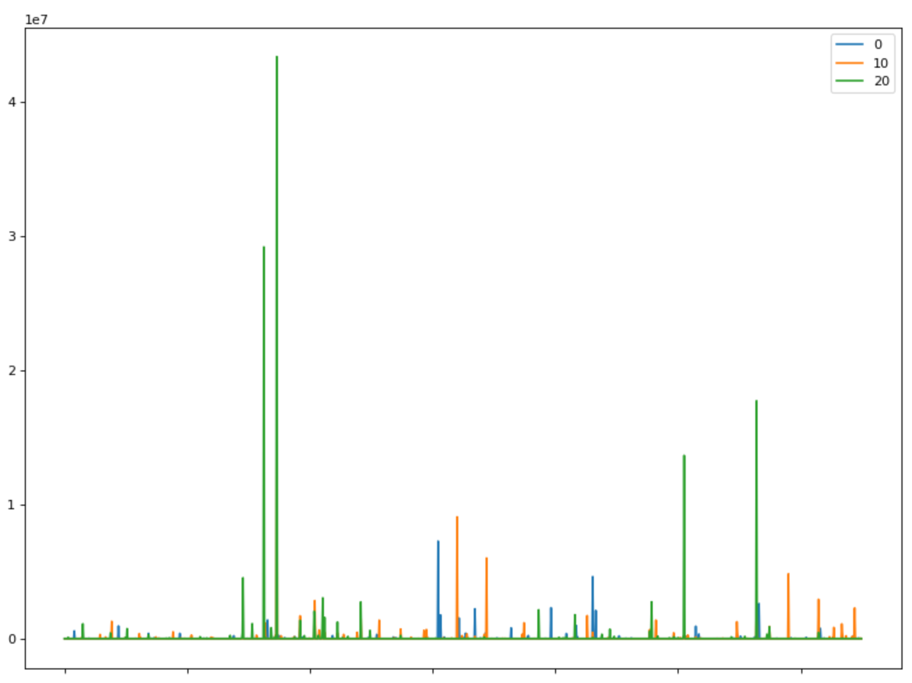
Pure Sample Spectra
Three different spectra that look unique

Slide 3
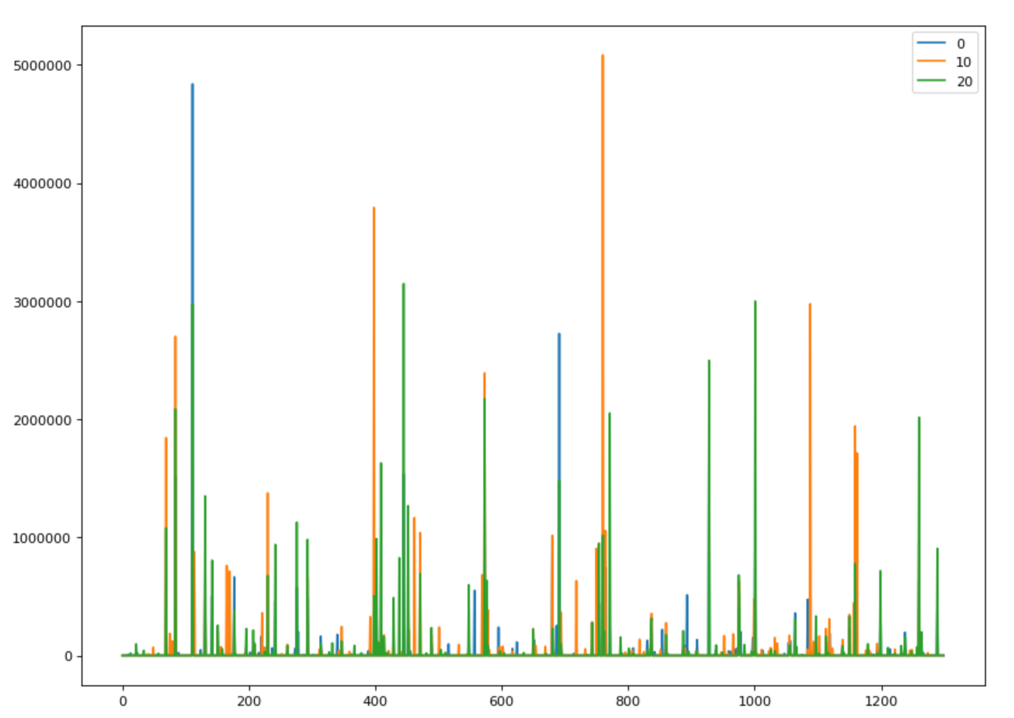
Mixed Spectra
More peaks for each spectra

Slide 4
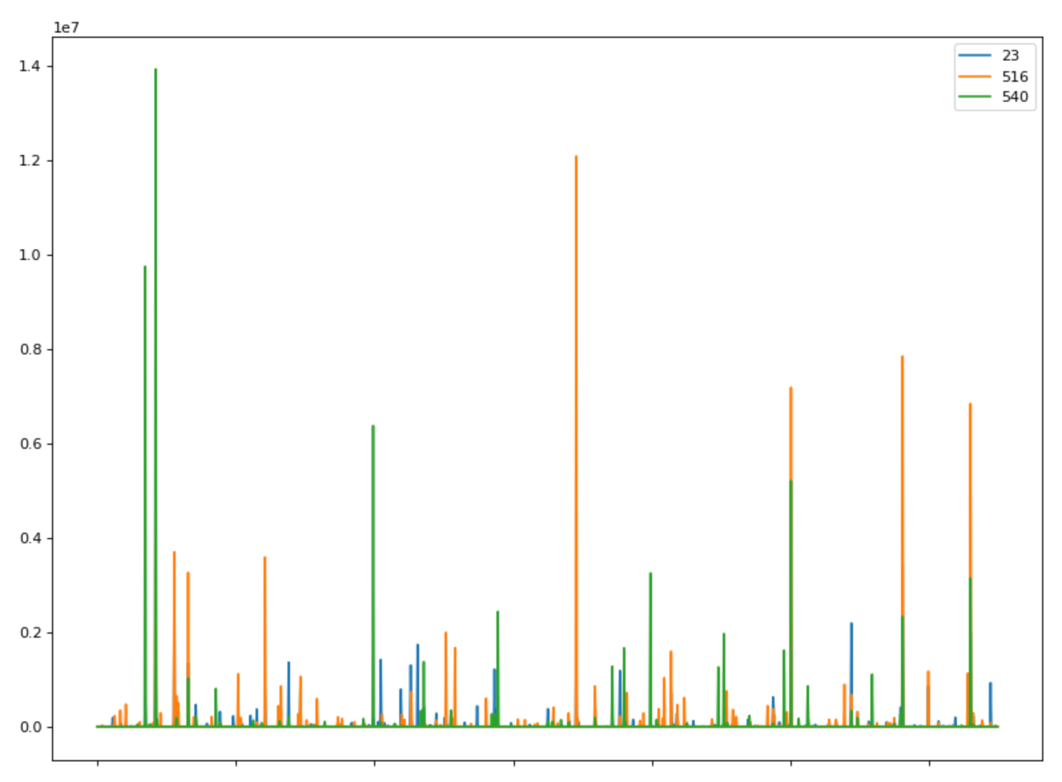
Mixed Spectrum (23) and Pure Spectra
There doesn’t appear to be much overlap. There is even some overlap from the two pure spectra

Slide 5
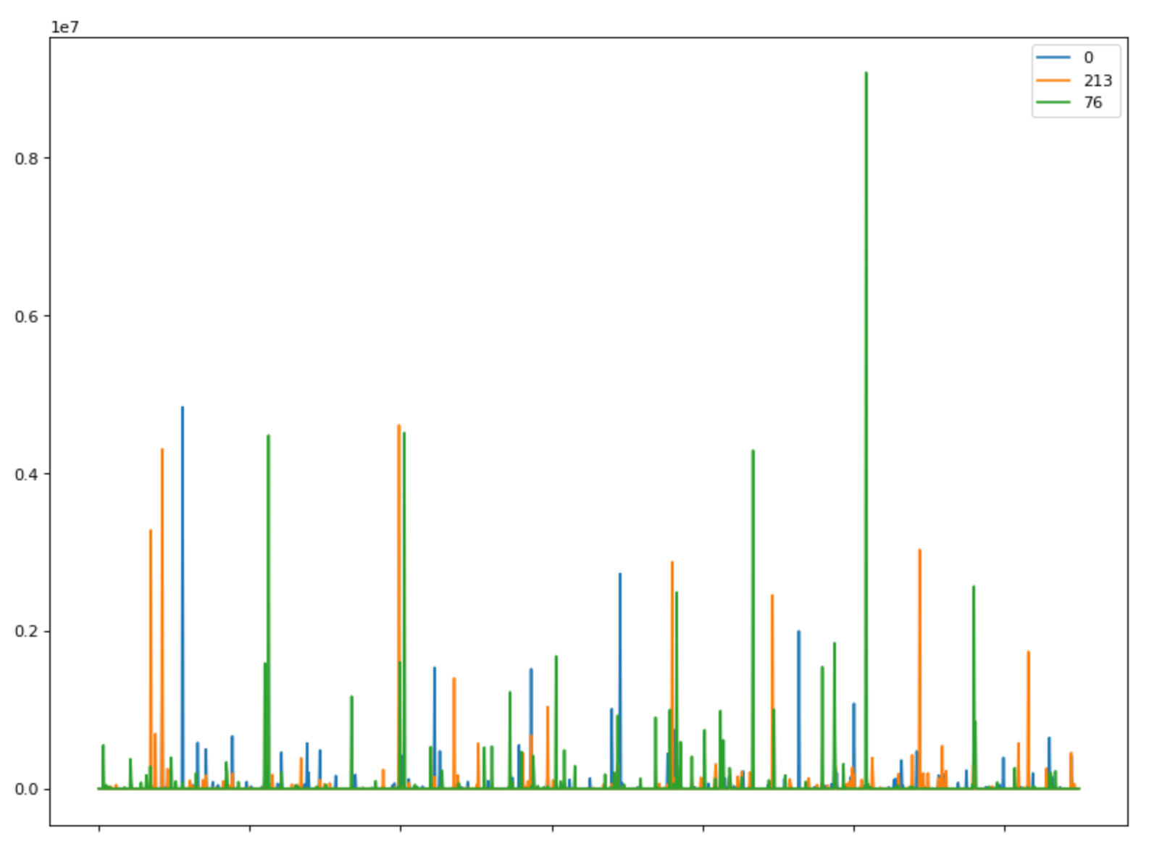
Mixed Spectrum (0) and Pure Spectra (213 not in mixed; 76)
There doesn’t appear to be much overlap again. The sample from one spectrum is not included in the mixed spectrum

